Slide 1
BTMW 4012 TECHNOLOGY ENTREPRENEURSHIP LECTURE 5 MARKETING PLANNING (Part 2) : Social Media Marketing

Slide 2

FACEBOOK
Digital Commerce - Cross Border Commerce
Explore Digital Entrepreneurship With
Copyright MDEC
Let’s Get Started

Slide 3
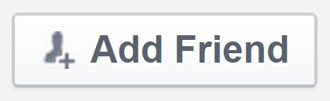








Facebook
Copyright MDEC
Profile
Group
Page
Individuals
Interest Groups
Benefit Weakness
Businesses or Organizations
Benefit Weakness
Benefit
Weakness
Add friends
Limited to 5,000 friends
Share thoughts, ideas and
activities
Interest groups are not popular
Create
content and
advertisements on Facebook
Irrelevant
advertisement will annoy your audience
Updates on
Facebook Posts can only
profile reach up to 5% of friends
Posts can only
Interact with reach group
group members members
Targeted
advertisement
Privacy
concerns
Access to Facebook
Insights for statistics
Posts can only reach followers

Slide 4
Difference Between Organic & Paid Post
Copyright MDEC
Organic
Paid
The number of people who have seen your post through unpaid distribution.
Paid ads allow you to target people who have not liked your page but have similar
interests and/or demographics
Publish posts for free
Keep people coming back to your page, clicking on your posts and sharing your content.
Target your post to the right audience
directly aligned with your business
outcome
Create high quality content and interact with fans

Slide 5
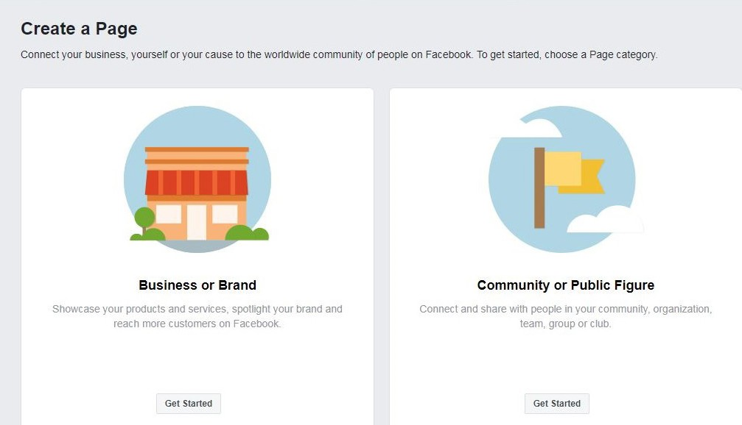
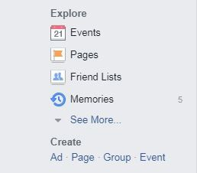
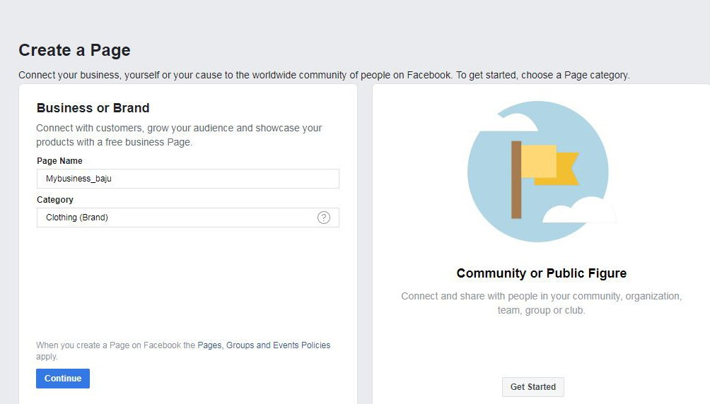
How to Create A Facebook Business Page
Copyright MDEC
1
Open Facebook Profile and click
Create Page
3
Fill in the business name and select the business
category. Click Continue.
2
For a business page, go to Business
or Brand and click Get Started.

Slide 6
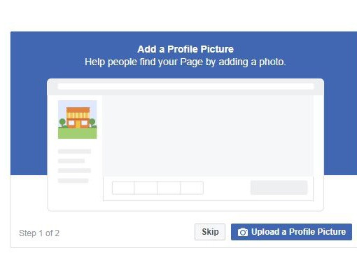
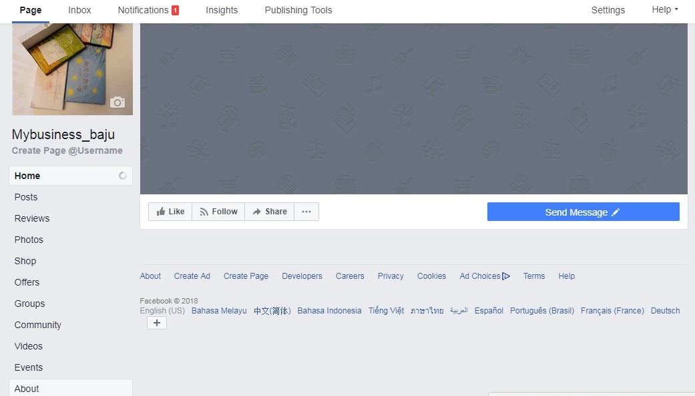
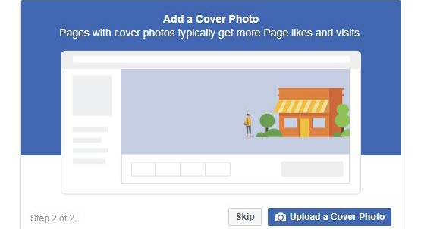
Copyright MDEC
How to Create A Facebook Business Page (Continued)
5
Upload a Cover Photo
4
Upload a Profile Picture
6
Your Facebook Page is ready. Click on About to edit information about your business.

Slide 7
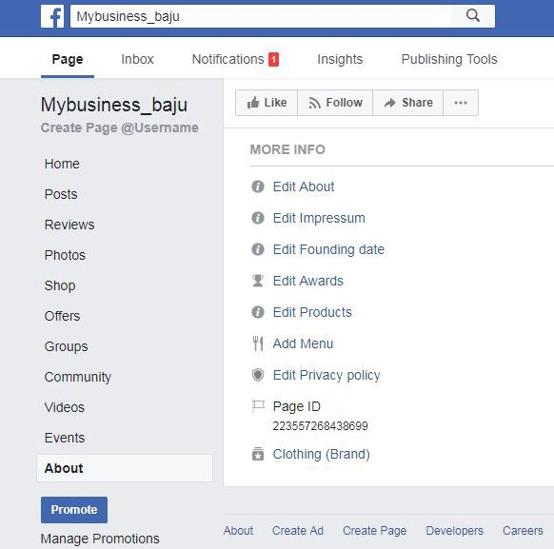
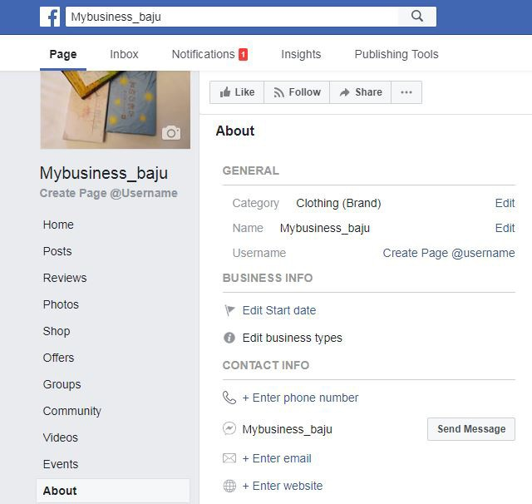
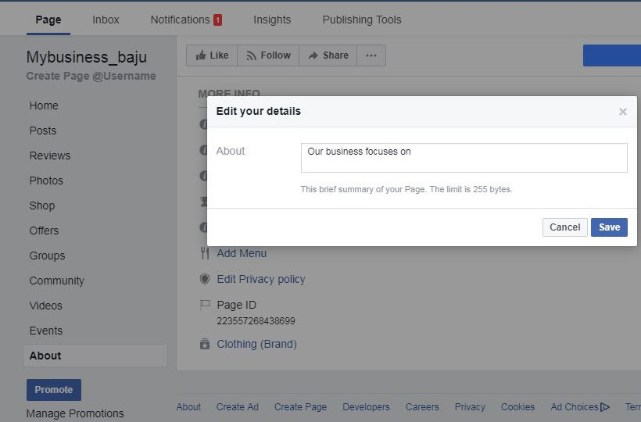
Copyright MDEC
How to Create A Facebook Business Page (Continued)
7
Add information such as your website, email and phone number.
9
Fill in details to enable prospects to get more information related to your business.
8
Click Edit About

Slide 8
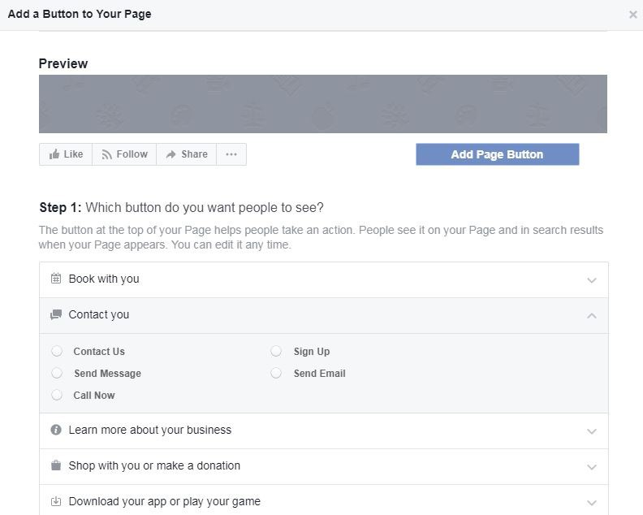
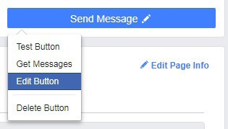
Copyright MDEC
How to Create A Facebook Business Page (Continued)
10
Edit Call to Action (CTA)
button for prospects to get in touch with you.
11
You can select CTA buttons that suits your business.

Slide 9

Copyright MDEC
Tips on Naming the Facebook Page
1
Use company name or brand
2
Use a general name: For entrepreneurs who sell other people’s products as agents, they can use a general name as branding. Trust will be built over time through purchases. This method provides flexibility to sell other products
3
Use product name
4
Create a unique URL for your Facebook (www.facebook.com/yourBusinessName) so your audience can access your page easily
SEO
5
The URL is important for Google SEO. If your URL is maintained at default, it cannot be easily identified and searched through the search engine and it will look unprofessional
6
The number of “Likes” must be more than 25 to change the URL

Slide 10
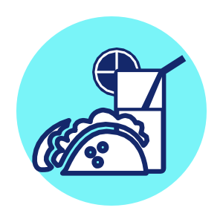

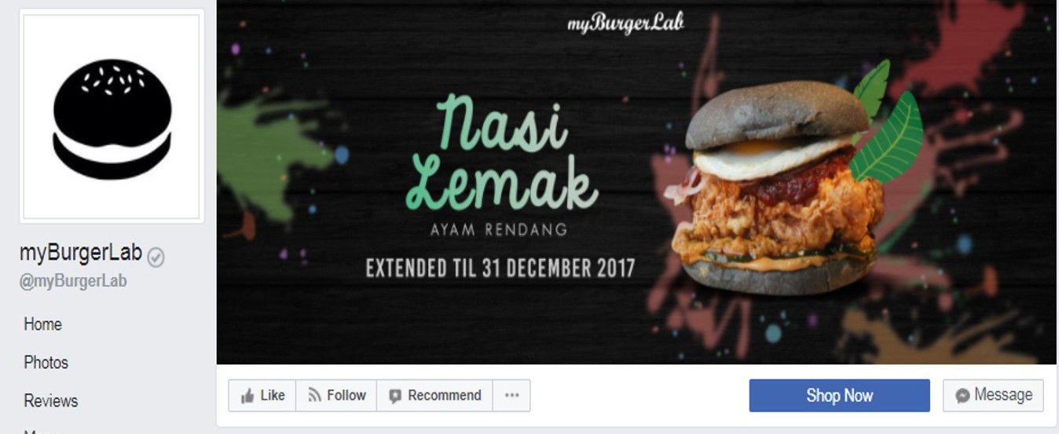
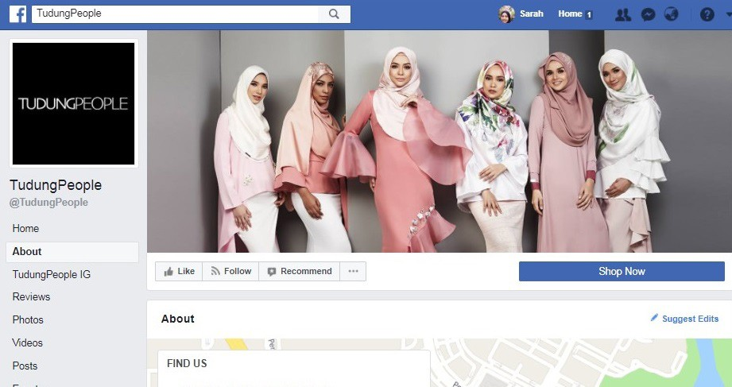
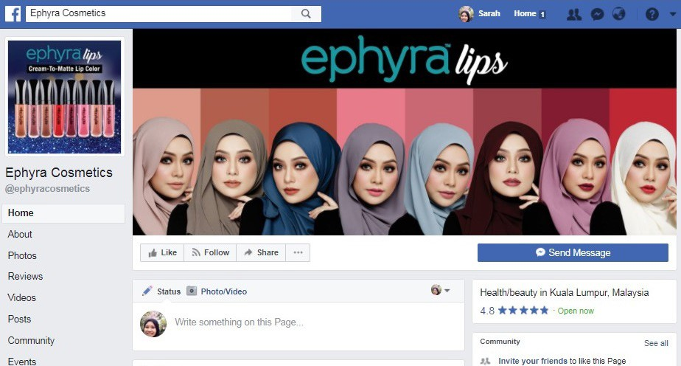
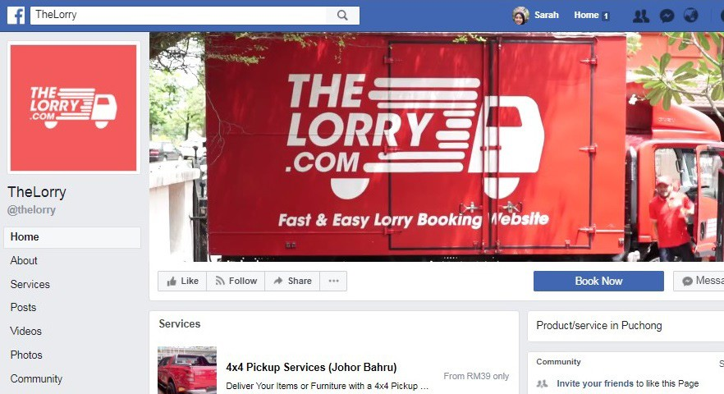
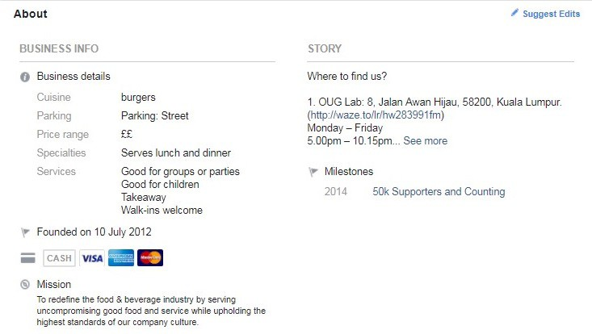
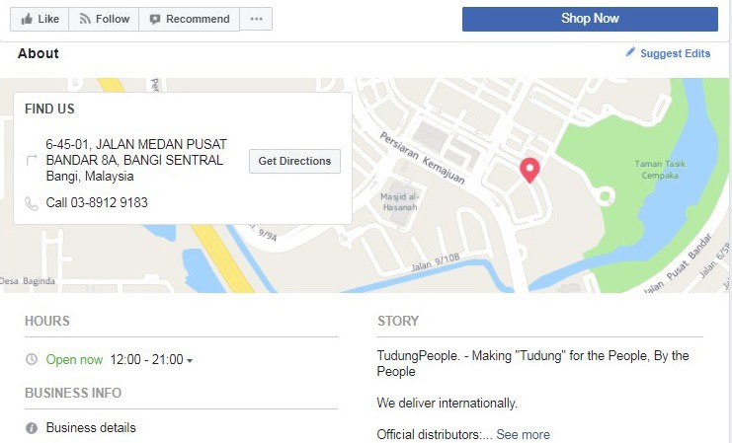
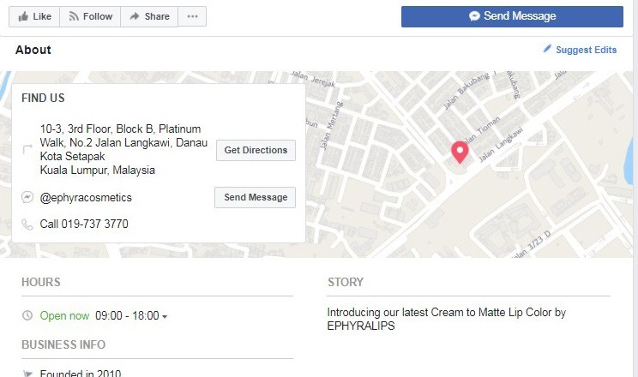
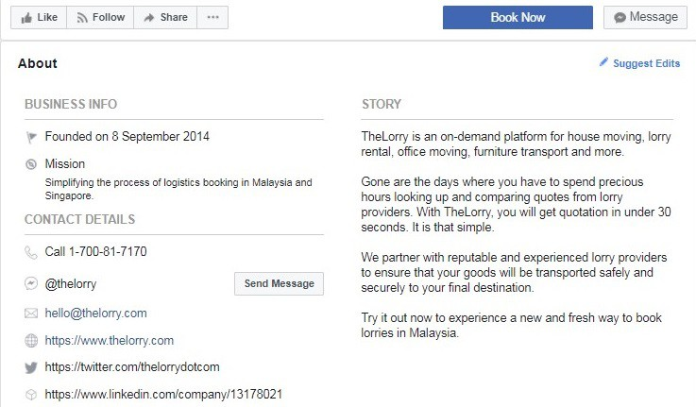
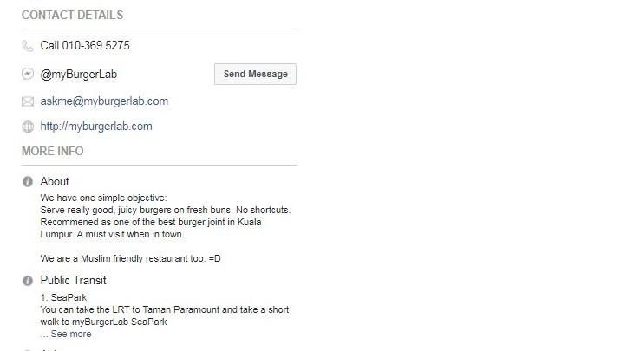
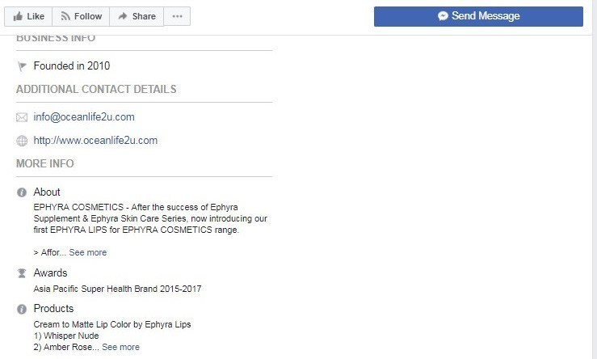
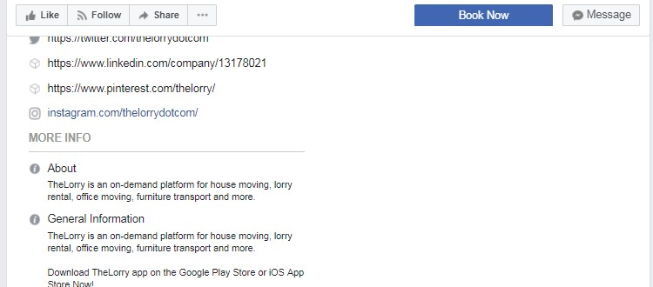
Sample of a Facebook Page
Copyright MDEC
Food & Beverage
Fashion
Health & Beauty
Service

Slide 11




Facebook Advertising Objectives
Copyright MDEC
Attracting the Right Audience
Advertising to create awareness of the product, service and brand.
Awareness
Keeping Your Audience
Further amplifying customer awareness of a
product, service and brand. To maintain, attract new and potential customers.
Consideration
Moving Prospects to a Desired Action
Aid in decision making and increase buying intent.
Conversion

Slide 12
Optimal Decision Tree
Copyright MDEC
Determine your objective. It has to be specific to reach targeted audience
Brand Awareness
I want people to develop a perception
Brand
Reach
Engagement
What am I trying to achieve with this campaign?
Video Views
App Installs
I want people to take an action
Direct Response
Lead Generation
Conversions
Store Visits

Slide 13


What Factors Are Considered
Copyright MDEC
The ad that wins an auction and gets shown is the one with the highest total value. Total value isn't how much an advertiser is willing to pay us to show their ad. It's combination of 3 major factors:
Bid
Estimated Action Rates
Ad Quality & Relevance

Slide 14
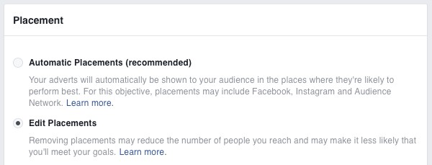
Facebook Advertising Placement
Copyright MDEC
By default, Facebook will determine where the advertisement will be displayed. However, you can select your preference by choosing Edit Placements.

Slide 15
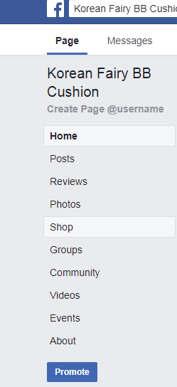
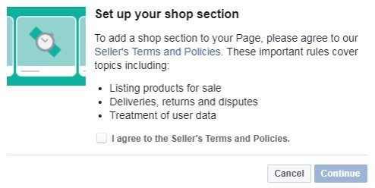
Copyright MDEC
Facebook Shop
Interested customers can send private messages to the admin to inquire on the product displayed.
1 2
Click on Menu > Shop Section
Tick the Check Box and click Continue.

Slide 16
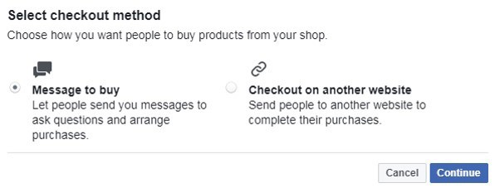
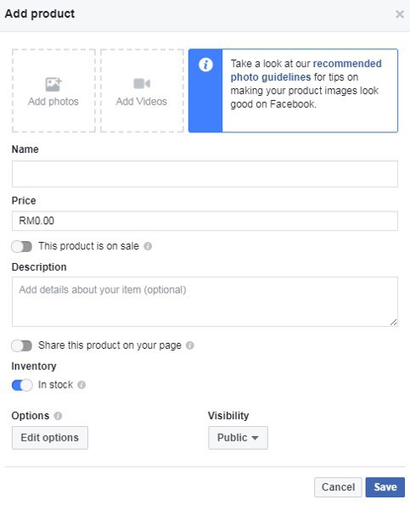
Copyright MDEC
Facebook Shop (Continued)
3
4
Upload your product image(s).
Fill in the details of your product(s)
and click Save.
Select preferred checkout method. Click Continue.

Slide 17
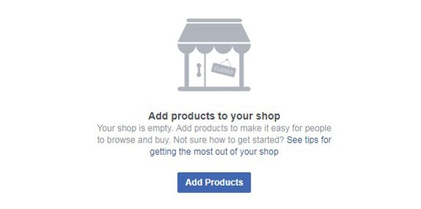
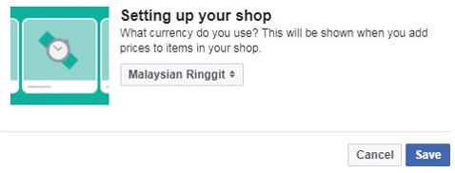
Copyright MDEC
Facebook Shop (Continued)
5
6
Click on Add Products to insert your products
on your Facebook Store.
Remember to set your default currency
to Malaysian Ringgit and click Save.

Slide 18
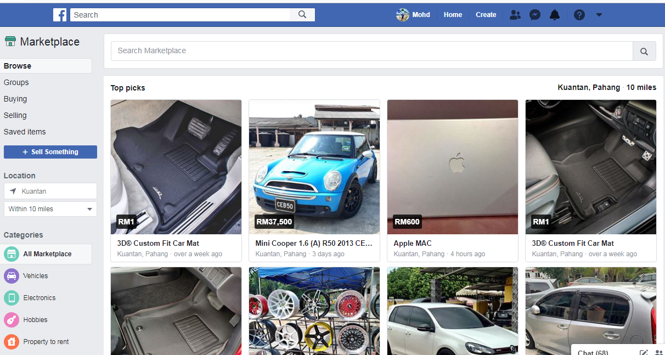
Facebook Marketplace
A feature by Facebook to encourage selling and buying activities among Facebook Users within accessible radius.
Using Facebook Messenger as the medium of communication.
Selling tips:
Use different image for different Ads to avoid “duplicate items” issue.
Create Ads in several nearby and accessible location for more potential prospects.
Use products’ keywords in Ads name and description as to increase suggestion listings.

Slide 19
LEARNING MATERIALS
NUM | TITLE | URL / Link
1 | How to create Facebook Ads | https://www.youtube.com/watch?v=sxgDwSto3mM
2 | How To Design Instagram Images In Canva | https://www.youtube.com/watch?v=Wl_tkLP86yQ
3 | Graphic Design For Newbies (Canva Tutorial 2019 - Canva 2.0) | https://www.youtube.com/watch?v=hiBAn1exlmc
4 | Sell Products Directly On Facebook with a Facebook Shop | https://www.youtube.com/watch?v=_GPZeo8wkGo
5 | Facebook Advertising: Audience Targeting on Facebook | https://www.youtube.com/watch?v=qF_G6VMNxr0

Slide 20

Explore Digital Entrepreneurship With
Copyright MDEC
INSTAGRAM
Digital Commerce - E-Commerce
Let’s Get Started

Slide 21
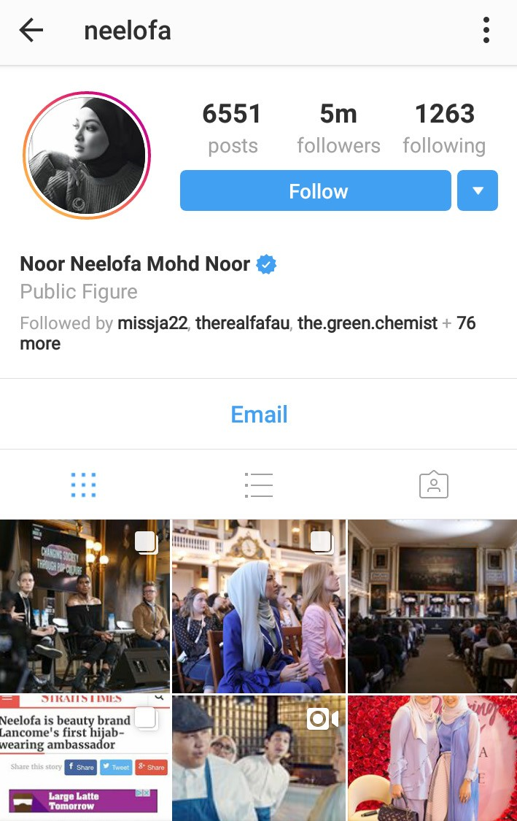
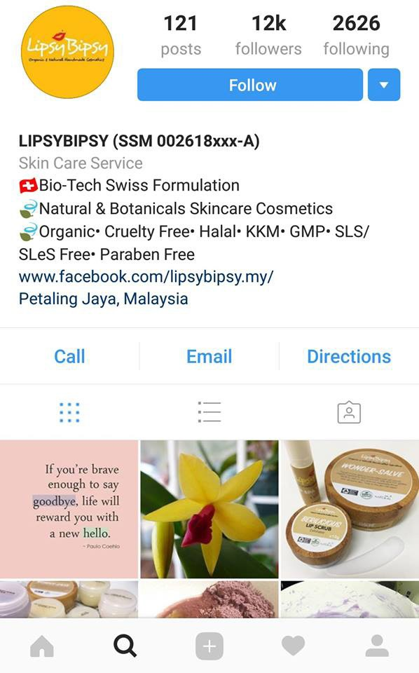
Types of Instagram Accounts
Copyright MDEC
Personal Account
Business Instagram Account
SSM Business Registration
Number
Business Name
Brief Description about Business
Website Link
Call to Action Buttons
Address Tips:
If you have a business
premise, include
business hours

Slide 22


Copyright MDEC
Difference between Personal and Business Account
Personal
Business
1
Posting of personal related media
1
Showcase your product and services,include CTA: address
and contact info to enable easy engagement
2
Cannot create advertisement & promotions
2
Ability to promote post and create paid advertisement
3
Does not have data insights
3
Access to Instagram Insights to analyze the efficiency of your account

Slide 23
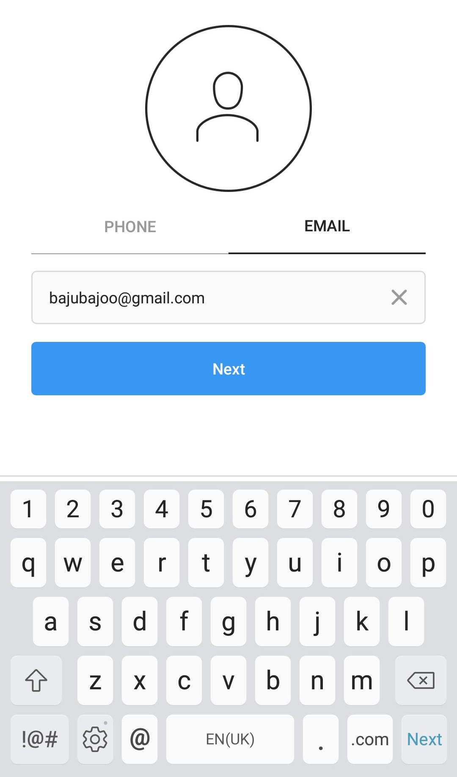
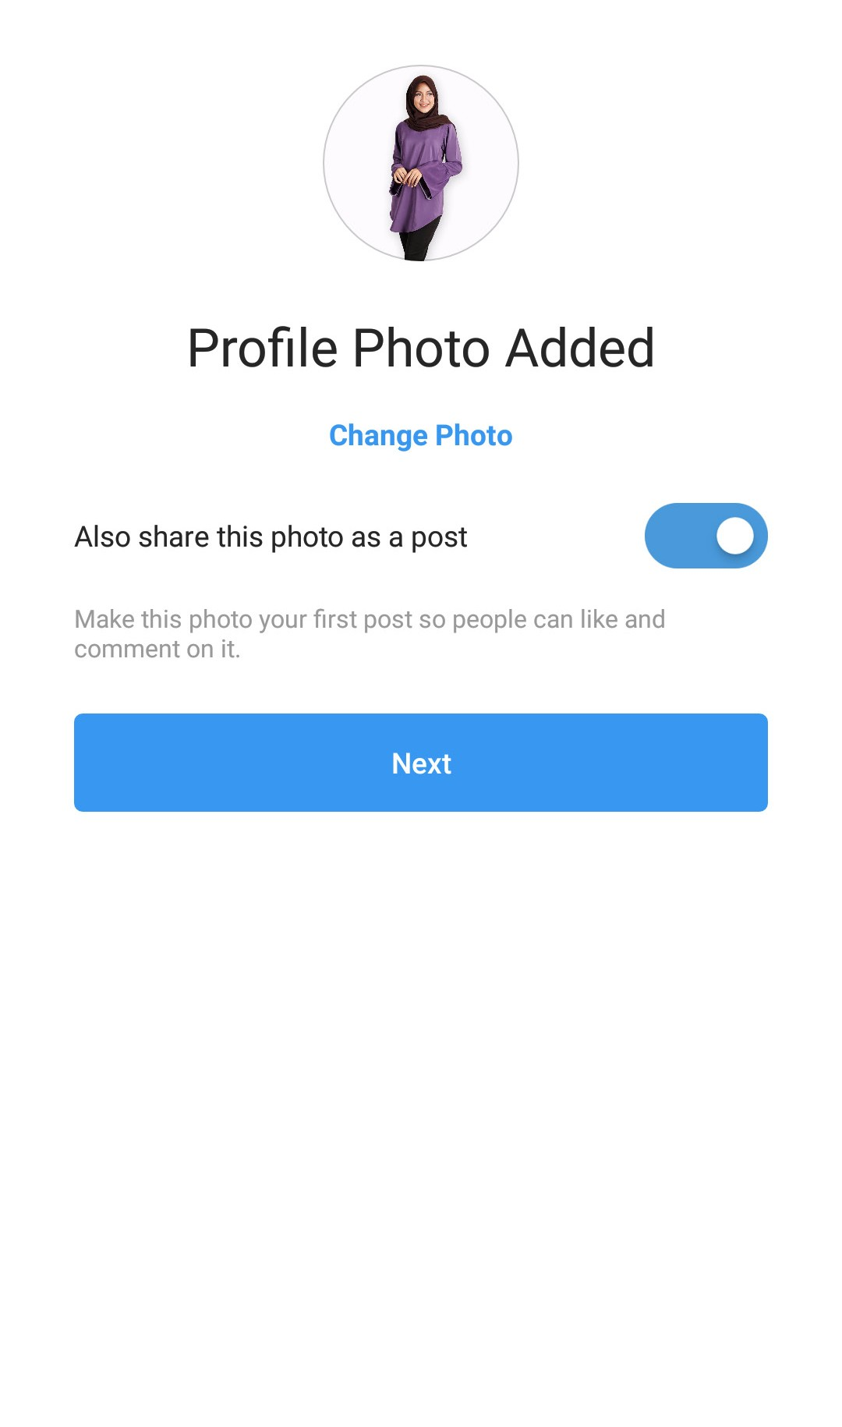
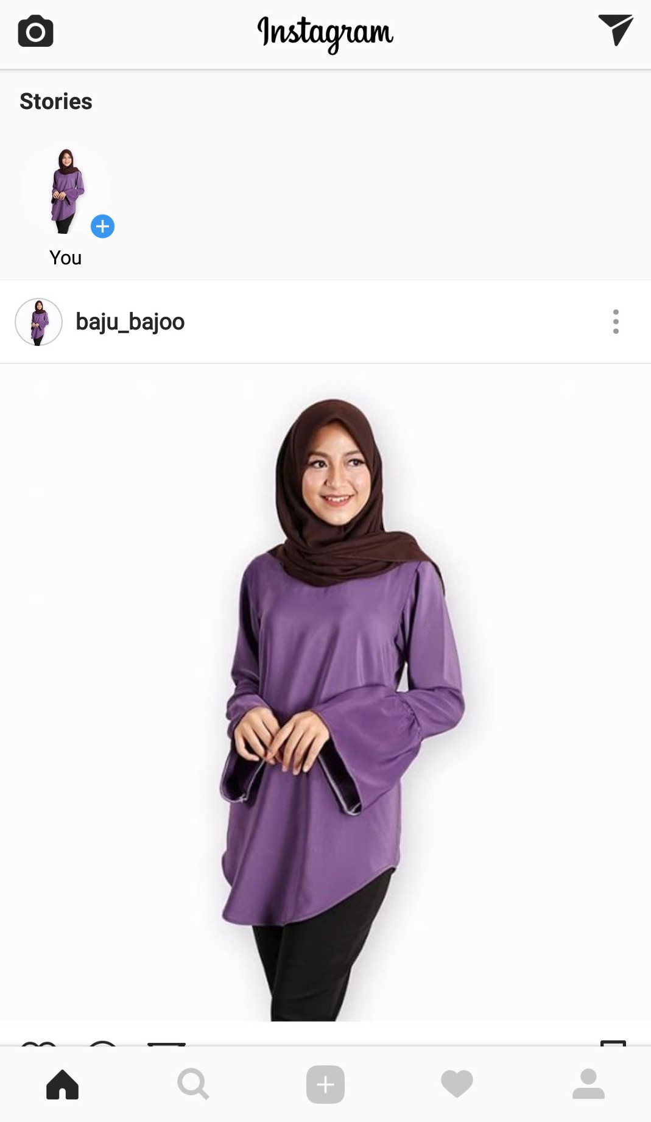
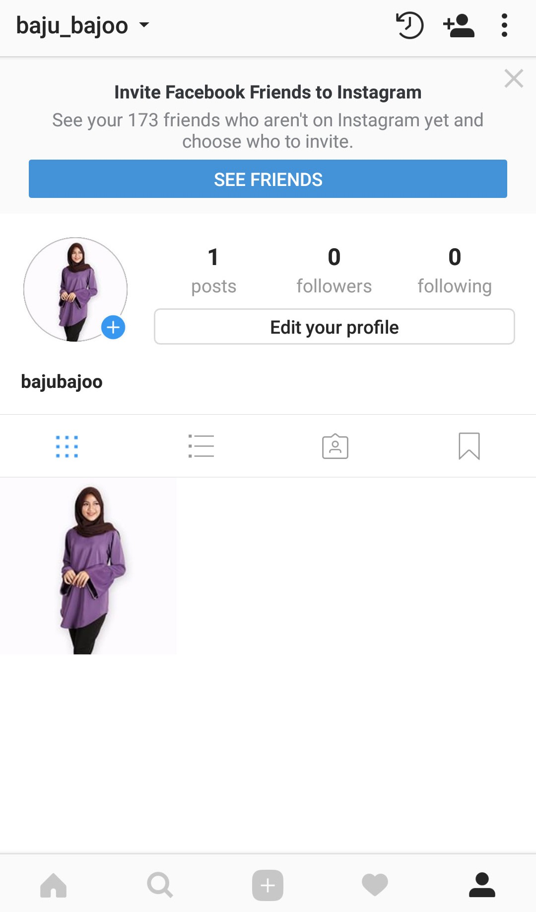
Setting Up an Instagram Business Account
Copyright MDEC
You can set up your Instagram account by registering it under your Facebook account or your email.
1
2
3
4
B
A
Open Instagram application and click Next. You can sign up via phone or email. Here we are using email
Add a Profile Photo
Your personal account is ready
To switch to a business account, click on the Person icon
And then click on the Options
icon

Slide 24
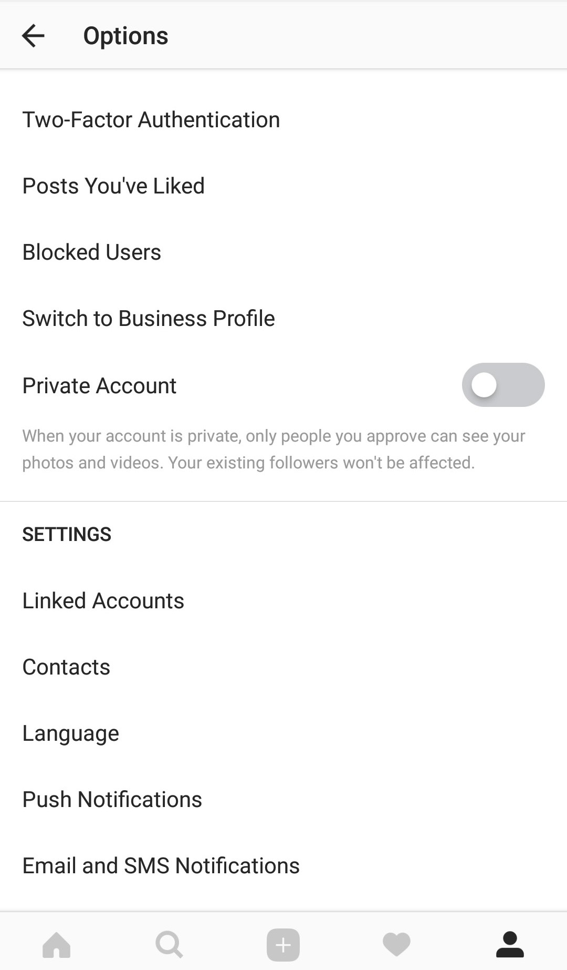
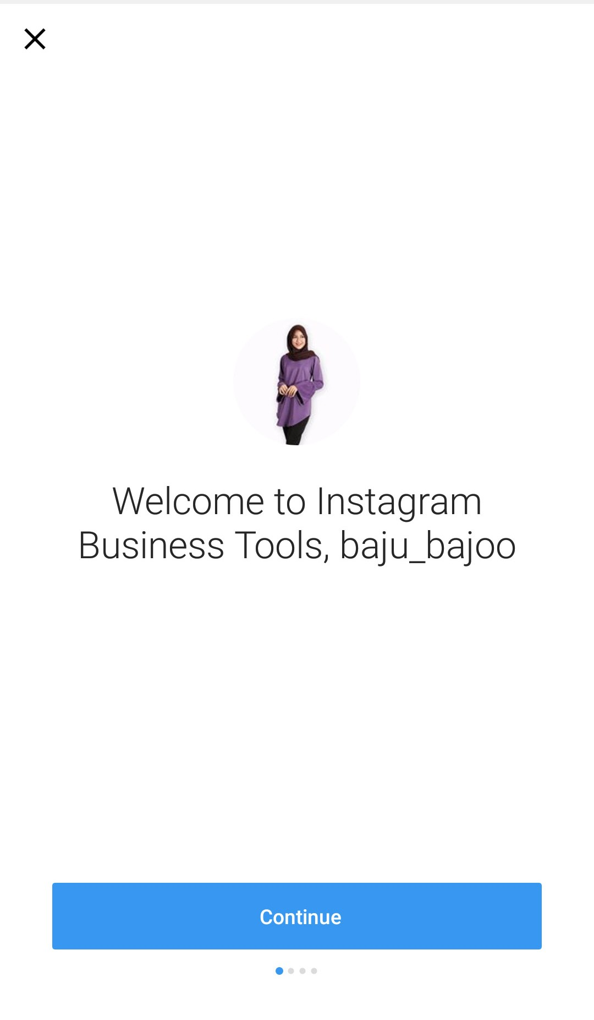
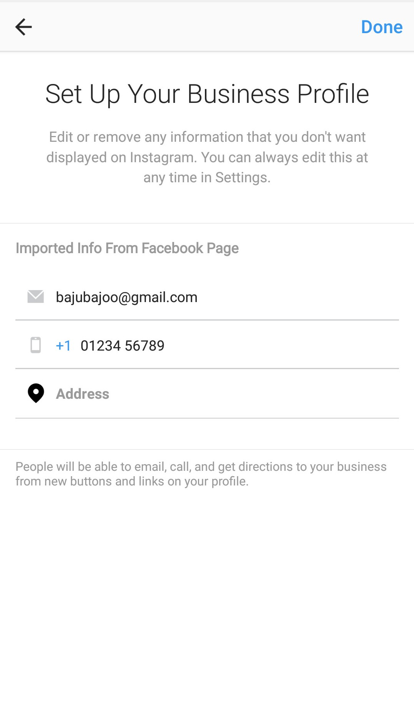
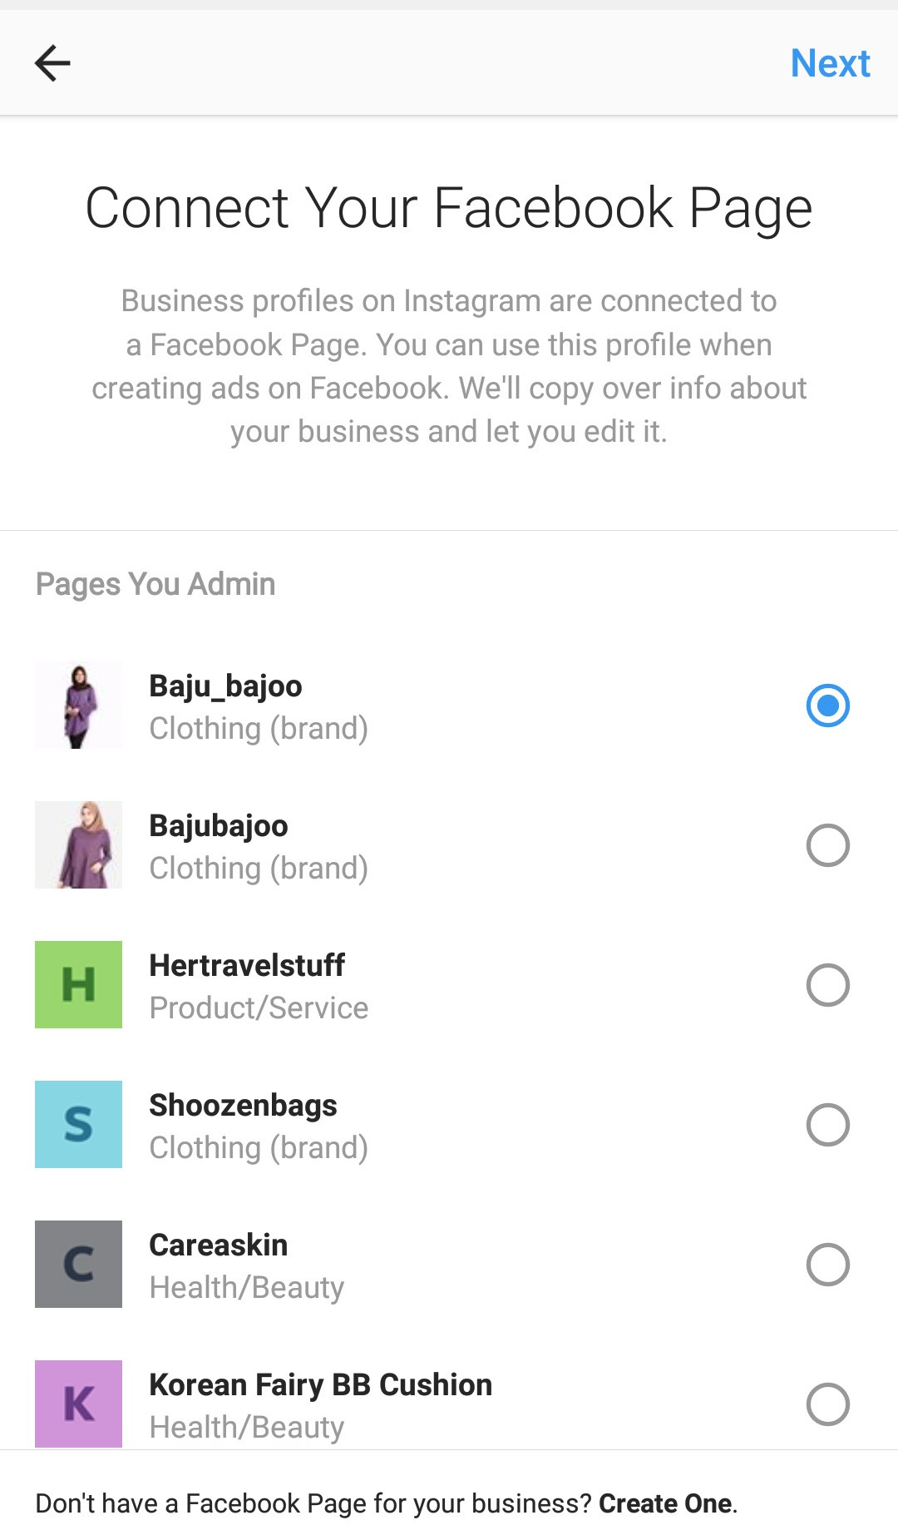
Setting Up an Instagram Business Account (Continued)
Copyright MDEC
5
6
7
8
Choose Switch to Business Profile
Click
Continue
Fill in the details as requested
Link your Instagram Business account with your Facebook page

Slide 25
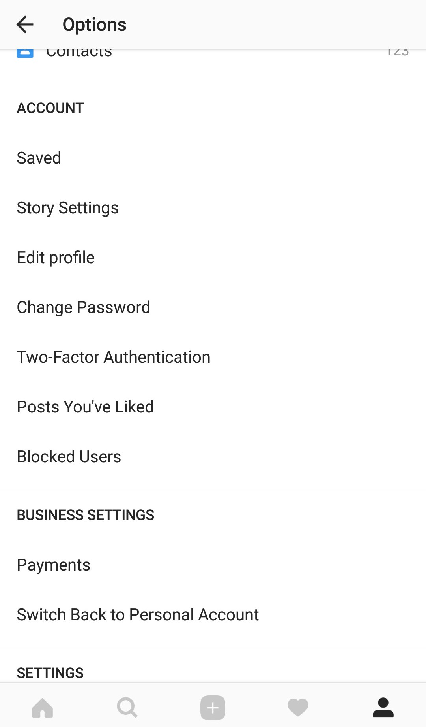
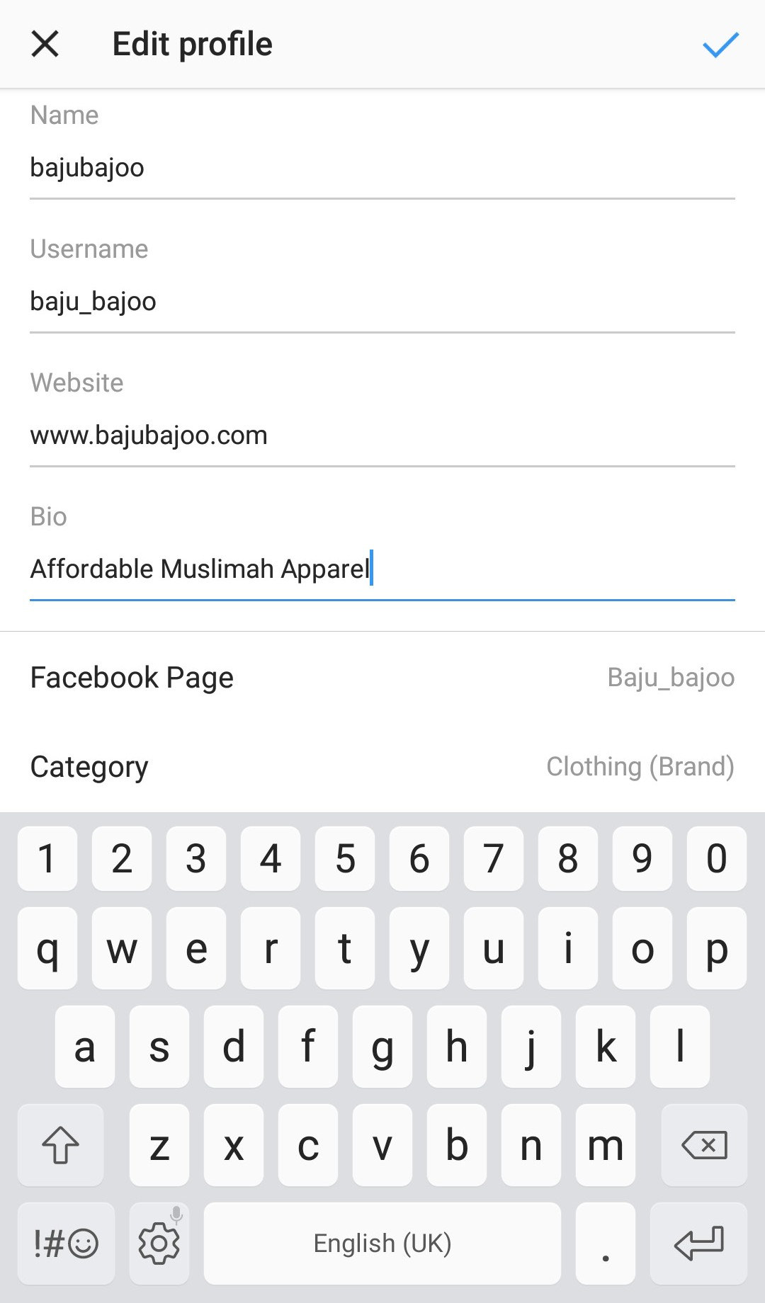
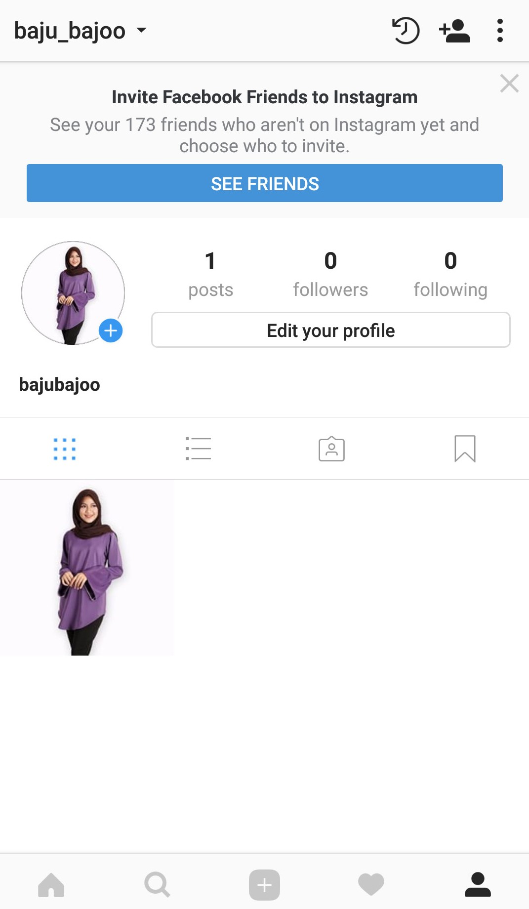

Setting Up an Instagram Business Account (Continued)
Copyright MDEC
9
10
11
Go to Options and click on Edit Profile
Fill in the details
Your Business Profile is ready for business

Slide 26
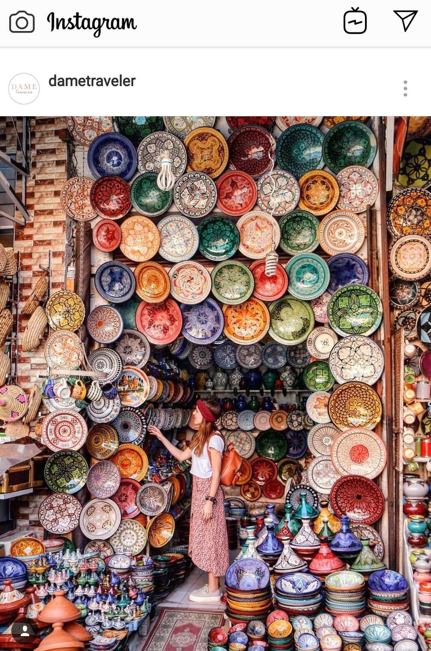
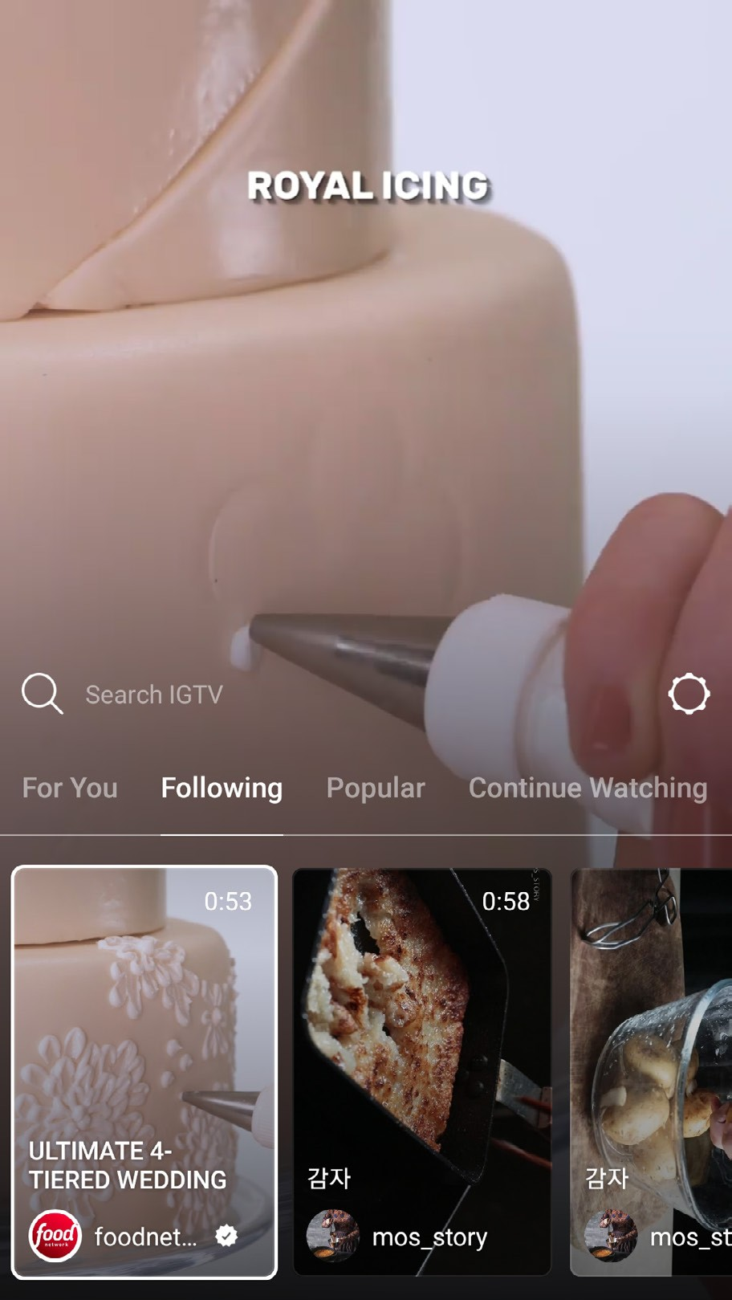
Types of Instagram Posts
Copyright MDEC
Photo
Video - IGTV
Users can Like, Comment and Share the videos
Entrepreneurs can utilize IGTV to showcase their product and interact with customers .
Instagram Stories
To view
videos, click on the IGTV icon.
You can select
the
channel.
Video (Until 60 Seconds)
Video – IGTV

Slide 27





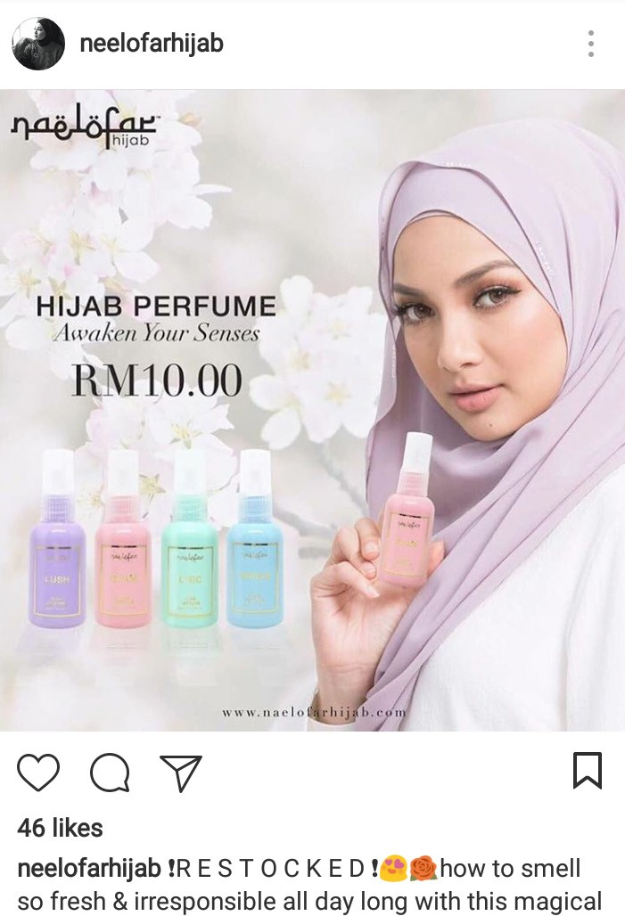
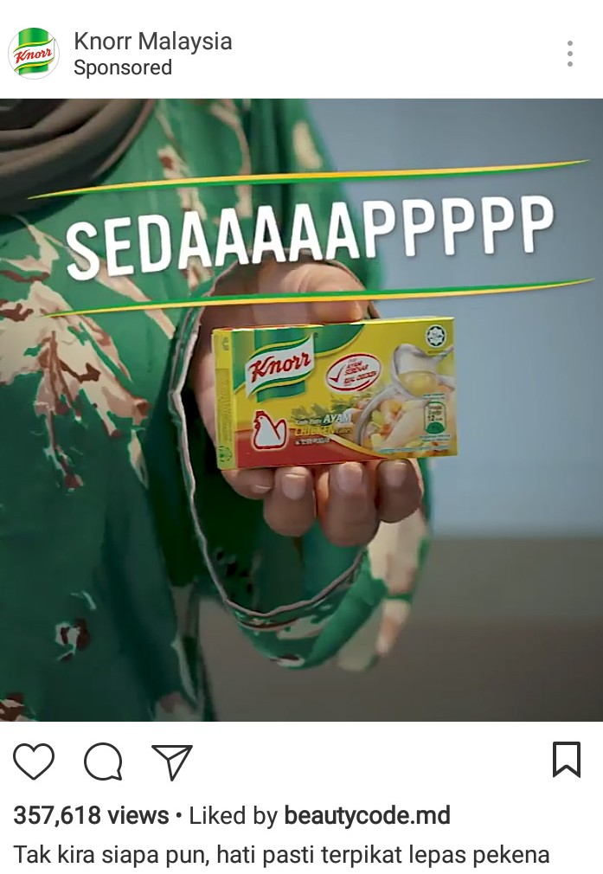
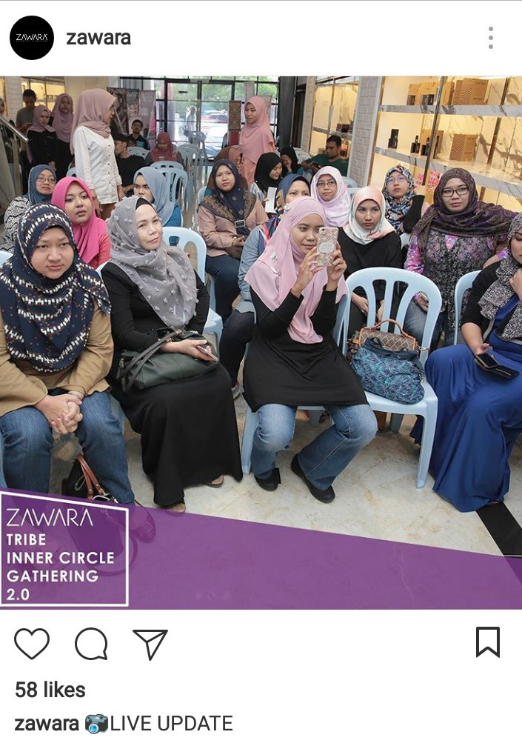


Types of Instagram Posts (Continued)
Photos
Copyright MDEC
Photos are the most posted content
on Instagram.
Message
Boost Sales
Brand Awareness
News and Updates
Consistent and Cohesive
Think of the visual concept of your account and stick to it to maintain the look and feel.
Tips:
Choose a colour palette and tone Choose a suitable font
Unique and Original
Show details of the product, colour choices,
design and
dimension.
Highlight the
brand such as the logo, the colour
and also the look
and feel.
Share the latest news and events to keep followers updated.

Slide 28




Types of Instagram Posts (Continued)
Photos
Copyright MDEC
Lighting
When shooting
indoors, find a spot by the windows and try to avoid artificial lighting.
Soft lighting
Safe to be applied
on all photos since it eliminates shadows and glare.
Hard lighting
Creates shadows,
contrast and results in a dramatic photo.
Natural Lighting
Early Morning
Before Sunset
Props
To make photos look more alive and interesting. Include accessories such as flowers, cutleries and stationeries.
Good
Indoor
Lighting
Window Light
Hard Lighting
Soft Lighting

Slide 29




Types of Instagram Posts (Continued)
Photos
Copyright MDEC
Rule of Thirds
Break your photo into 9 segments. Use this grid as guidance to compose your photo.
Along the red lines
Inside the boxes
At the intersection of the grids (Blue dots)

Slide 30





Types of Instagram Posts (Continued)
Copyright MDEC
Videos
Tutorials
How to use/style/wear your product and portray the lifestyle of users using it.
Creative Process and Quality of Product
Videos of sketches of your upcoming product, visiting
the manufacturer and a sneak peek of the final product.

Slide 31





Types of Instagram Posts (Continued)
Copyright MDEC
Videos
Use Hashtags
Show Motion
Include motion in the first
few seconds
so it won’t be mistaken as an image.

Slide 32


Types of Instagram Posts (Continued)
Copyright MDEC
Videos
Subtitles
Call to Action (CTA)
Include
subtitles as Instagram
videos
will play
automatically on mute
Add Call to Action (CTA)
Book Now Sign Up
Contact Us Shop Now Install Now

Slide 33




Types of Instagram Posts (Continued)
Instagram Stories
Copyright MDEC
The feature also include filters and can be enhanced with drawing.
Share current events,
sales or
promotion.
Share a new product or a sneak peek of your upcoming product.
Customers buying product at premise Process of creating a new product
Teaser of upcoming colours of new products
Tips: Best Posting Time
Before Office Hours After Office Hours

Slide 34







#Hashtags
Copyright MDEC
which were made popular by Twitter are now being used by other social networks including Instagram.
Classify Photos
Make it Searchable based on Keywords
Make your
Account
Public
Increase of
Sales and
Engagement
Increase
Awareness of
Product & Brand
People can
Search your
Photos via
Hashtags

Slide 35


#Hashtags
Copyright MDEC
Use hashtags :
1
Brand Positioning
2
Get Potential and
New Followers
Create your own unique hashtag for your business and encourage your followers and customers to use it
Instagrammers search for posts that contain hashtags
related to their interest

Slide 36

Types of #Hashtags
Copyright MDEC
Brand
Unique to your business
Community
Connects people with the same interest
Trending
Related to
current
events

Slide 37




How to Gain More Followers on Instagram
Copyright MDEC
1
2
3
High quality content
Follow other People, Groups or Associations on Instagram
Interact with other people on Instagram
Like Comment Share

Slide 38



Copyright MDEC
How to Gain More Followers on Instagram (Continued)
5
6
6
4
5
Run a contest to
increase awareness
Repost customer’s post especially if it is related to your product
Schedule posting so that followers can anticipate the next post and look forward to it

Slide 39



How to Gain More Followers on Instagram (Continued)
Copyright MDEC
7
8
9
Follow competitors’
accounts and study their followers
Use the Tags function to find related and trendy topics that you can use.
Work with influencers and come out with a collaborative post to get attention from more followers

Slide 40

Copyright MDEC
WhatsApp Direct Chat
A direct chat enables you to connect your Instagram business account with WhatsApp.

Slide 41






WhatsApp Direct Chat (Continued)
Copyright MDEC
1 4
5
6
A
Insert you phone number in this link : https://api.com/ send?phone=60104000196
Paste the WhatsApp link in the Paste Long URL
B
2
3
C
Go to bitly.com
Click on Create Bitlink
You will receive a Bitly link.
Edit to customize the link
Click Save
Paste the link in the Website section of your Instagram
business profile

Slide 42







Instagram Insights
Copyright MDEC
Go to Profile and click on the Status bar
Follower Insights
Follower
Posts
Stories
Follower Insights Data
Age Range
Impression
Reach
Gender
Website Click
Geographic
Followers

Slide 43





Instagram Insights (Continued)
Copyright MDEC
Post Section
Stories Section
Use these information to
Identify the Interest of Followers
Target New Followers
Post Preferred Content at Optimal Times

Slide 44
LEARNING MATERIALS
NUM | TITLE | URL
1 | How to create an Instagram Business Account (step by step) | https://www.youtube.com/watch?v=_r6QpQQythE
2
3
4
5

Slide 45




GOOGLE ADS
Digital Commerce – Cross Border Commerce
Explore Digital Entrepreneurship With
Copyright MDEC
Let’s Get Started

Slide 46

What is Google Ads?
CCooppyyrriigghhtt MMDDEECC
Google Ads is an online advertising tool that helps businesses connect with their customers.
Entrepreneurs bid on
keywords.
Users search on Google
Users see your ads
Customers base increase
TIPS
Google Ads is one of the most powerful online marketing tools to reach your targeted audience on different platforms

Slide 47





Where do Customers See Your Ads?
CCooppyyrriigghhtt MMDDEECC
Ads will be displayed in Google Search Network, Google Display Network, partner websites or mobile apps.
1
Google Search Network
Google.com search results
2
Google Display Network
YouTube Videos Mobile apps
News sites, blog & websites

Slide 48

Text Ads in Google Search Results
Copyright MDEC

Slide 49

Shopping Ads in Google Search Results
Copyright MDEC

Slide 50

Video Ads in YouTube
Copyright MDEC

Slide 51

Image Ads in Blog / Websites
Copyright MDEC

Slide 52


Advertising Cost on Google Network
Copyright MDEC
1
The more money you
spend does not
guarantee the top
or highest ads ranking.
Google Ads is based on an auction system
You can start to advertise
with a minimum of RM1
High quality ad campaign
Lower cost
Ad
Placement

Slide 53




How it Works?
Copyright MDEC
Auction process:
A user performs a search on Google
Auction begins when the
keyword has a bid on it
Google will determine your
ad rank and cost per click
For example:
User searches for “cheap
flights KL” on Google
5 companies bid on the
keyword “cheap flights
KL”
Google will determine which company ads to show at 1st place, 2nd place and so on.

Slide 54
LEARNING MATERIALS
NUM | TITLE | URL
1 | Google Ads Tutorial 2019 | https://www.youtube.com/watch?v=aqzR2Ki2Ka4
2
3
4

Slide 55
MANAGING MARKETING ACTIVITIES (2)
The Marketing Budget
ITEMS | FIXED ASSETS EXPENSES (RM) | MONTHLY EXPENSES (RM) | OTHER EXPENSES (RM)
Signboard Marketing Personnel Salary Commission EPF/SOCSO Travelling Promotion Grand Opening | 300 | 5,000 5,000 1,000 2,000 | 10,000 5,000
Total | 300 | 13,5000 | 15,000

